Slide 1

Hagrid’s HARVEST
TEAM: WICK-149

Slide 2

Agenda
Introduction​
ER​
Relational Schema
Star Schema
Live Demo
Summary​

Slide 3

Introduction
Unleash the magic at Hagrid's Harvest, where freshness and abundance meet. Inspired by Hagrid's abundant supplies to Hogwarts, we offer premium produce, meats, pantry essentials, and more. With sustainable practices and top-notch products, ignite your culinary passion in our inviting store. Discover the enchantment of Hagrid's Harvest for an extraordinary shopping experience.

Slide 4
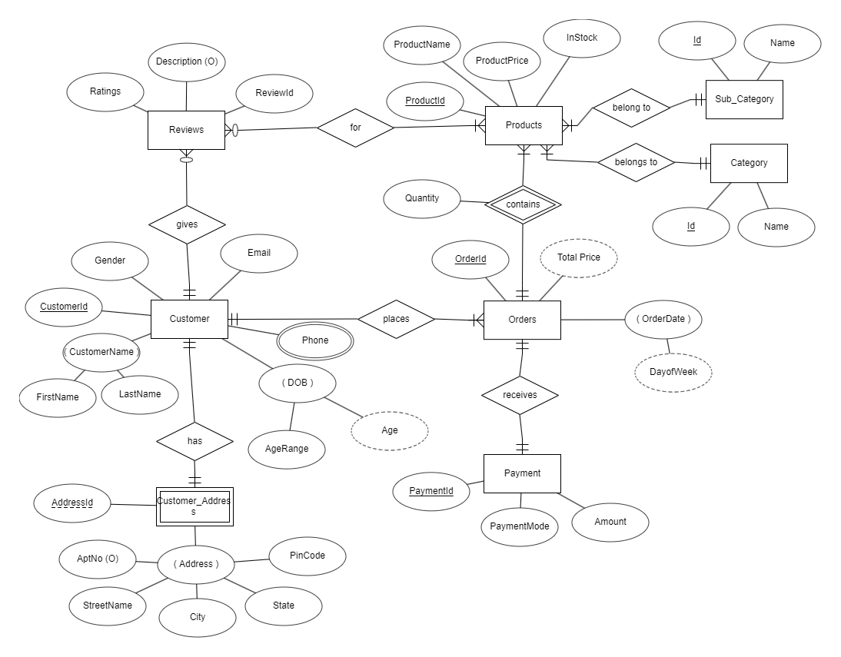
ER Diagram

Slide 5
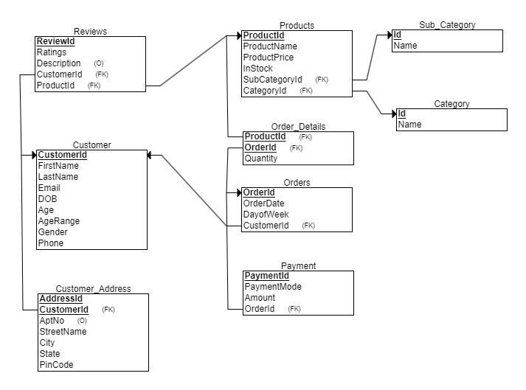
Relational Schema

Slide 6
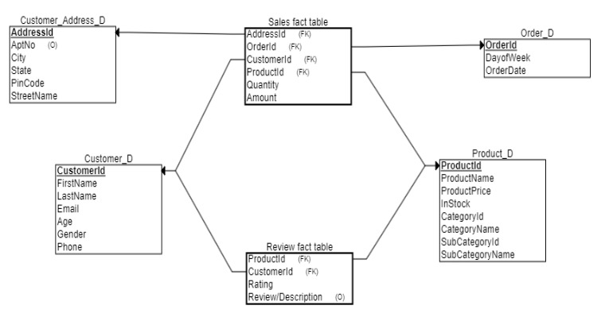
STAR Schema

Slide 7

Live demo
Now lets see the live demo of our app
Operational database
Analytical database

Slide 8
Summary
Our e-commerce operational database successfully stores and manages transactional data related to the day-to-day operations. It serves as a central repository for storing information such as customer data, product details, orders, inventory, and other operational aspects of the e-commerce platform.
Also the data warehouse structure allows for efficient querying, reporting, and integration with analytical tools, enabling you to make data-driven decisions, optimize business operations, and enhance the overall customer experience.

Slide 9
THANKYOU

